Slide 1
Multilayer Perceptron
http://bit.ly/2Hvf7yG

Slide 2
Order of the day
Quiz
Why Neural Networks
Review Perceptron
Neural Networks
Activation functions
Use Colab

Slide 3
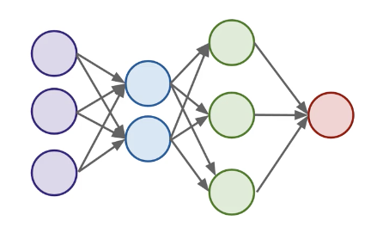
Why Neural Networks?
?

Slide 4
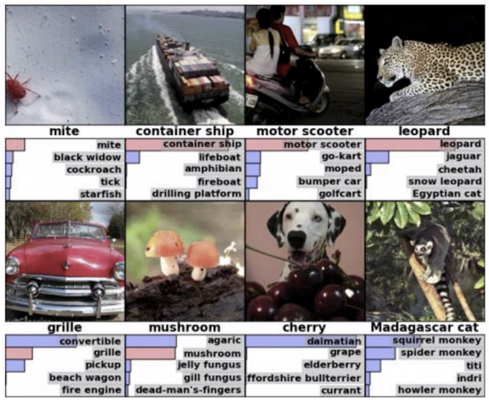
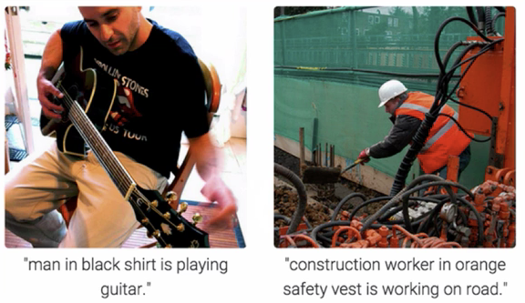
Object Recognition and Caption

Slide 5

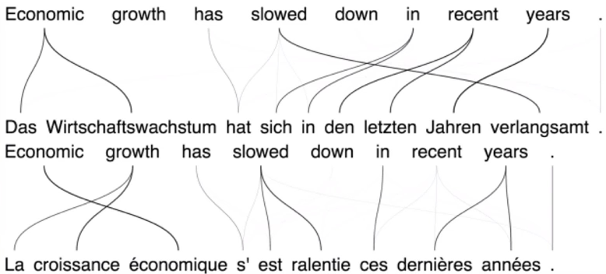
Neural Machine Translation

Slide 6
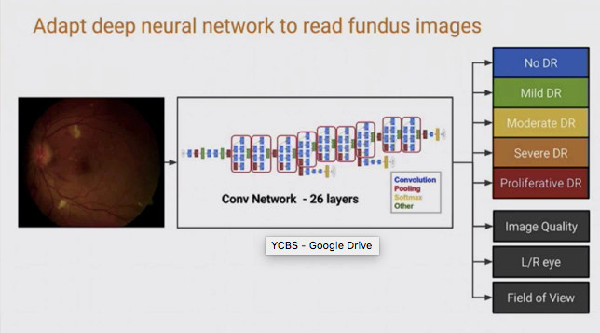
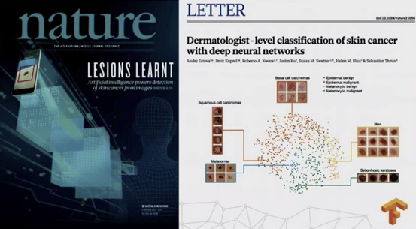
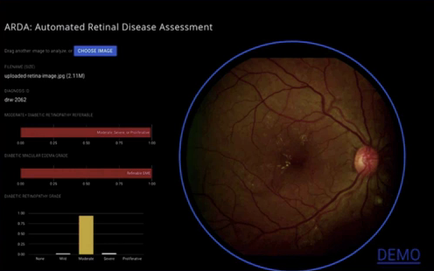
Medical Imaging / Diagnostic

Slide 7
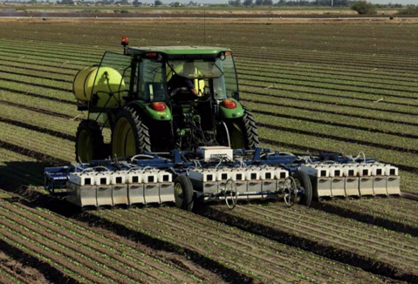
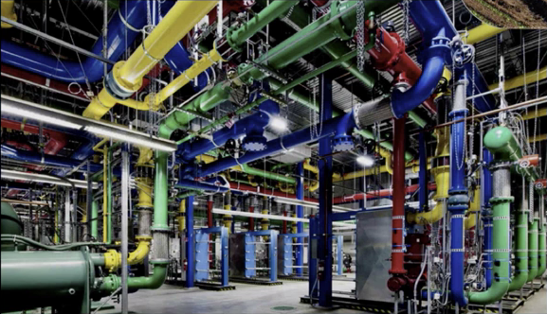
Cooling Data Center
Optimizing Agriculture yields

Slide 8
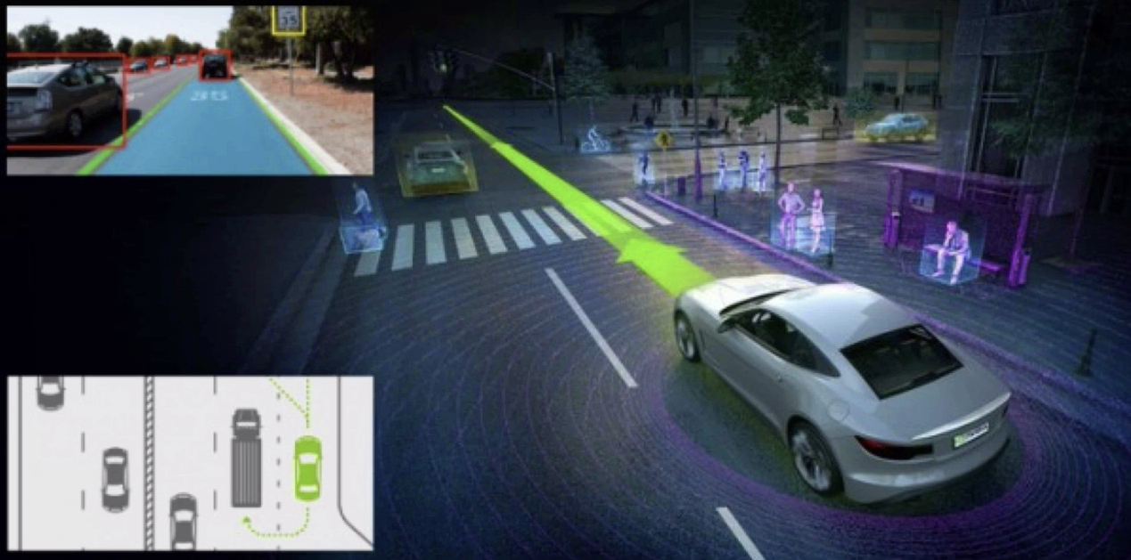
Self-Driving Cars

Slide 9
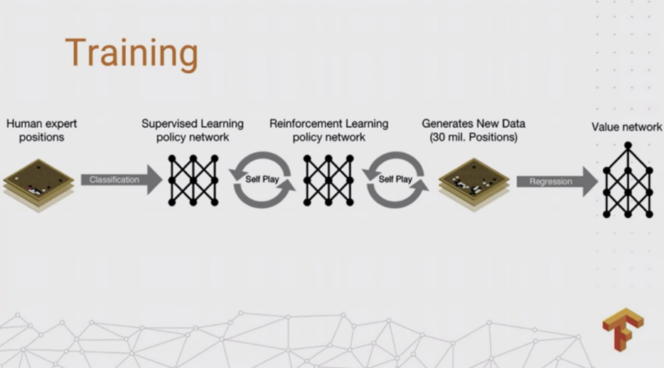
Alpha Go

Slide 10

Speech and Image Synth

Slide 11
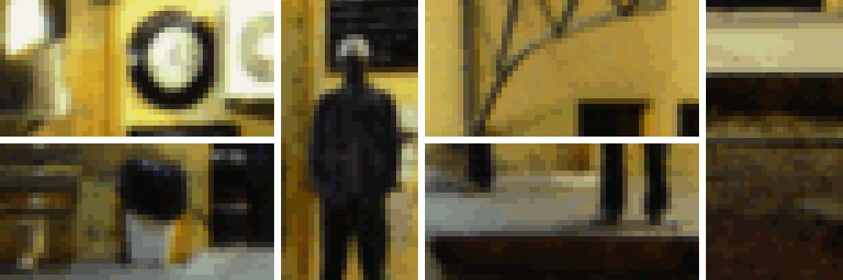
Enhance! (link)

Slide 12

Lipreading

Slide 13
Aside from that…
Businesses use DNN’s for
Decision making on similar data
Decision Making
Diagnostics
Identifying anomalies
Classification: fraud, CRM, Tagging, Text, Responding to events, Marketing, Recommendations, Spam
Regression: Valuation, Timing, Correlations, Requirements
Forecasting trends/events
System / Process / Parameter optimization
“Gloried Curve Fitting”
Judea Pearl
(link)

Slide 14
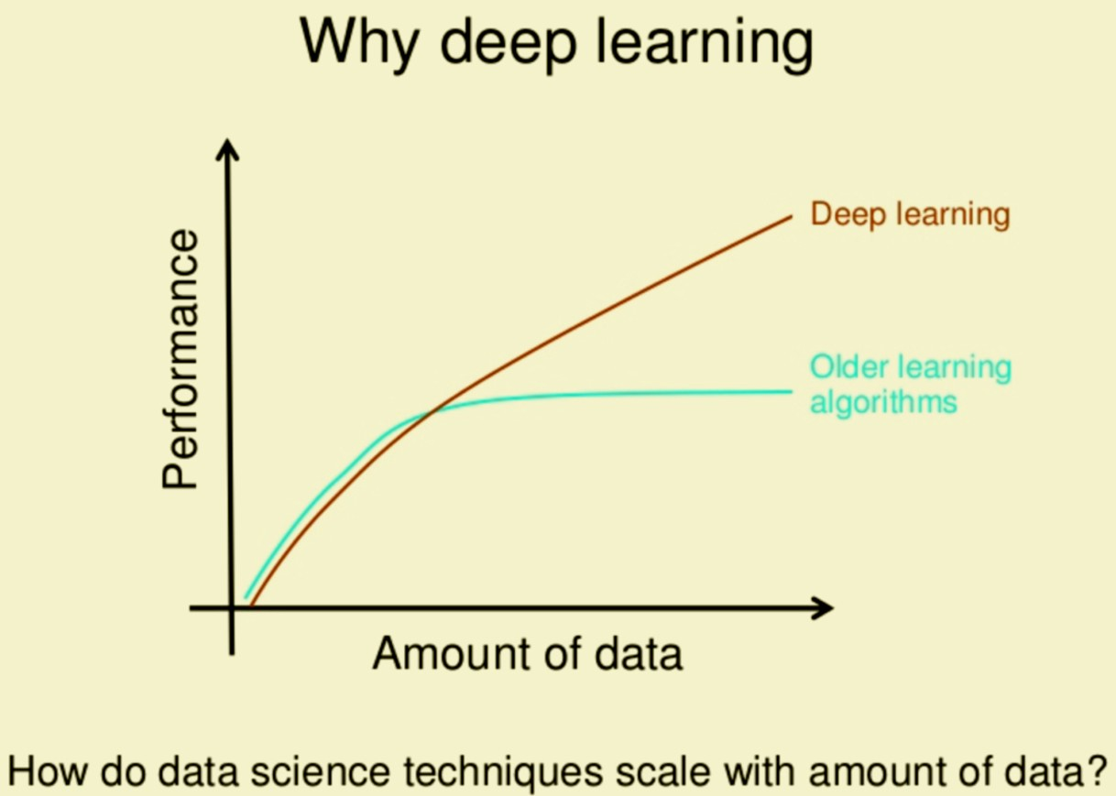

But Why? (oversimplification)
Deep Learning | Traditional ML
Input Model Output | Input Feature Extraction Features Model Output
*think no free lunch

Slide 15
So why DL?
It works for complex unstructured problems like images, videos, audio, time series and games
Performance with more data
Auto feature, no/little domain expertise needed

Slide 16
A review of the Perceptron

Slide 17
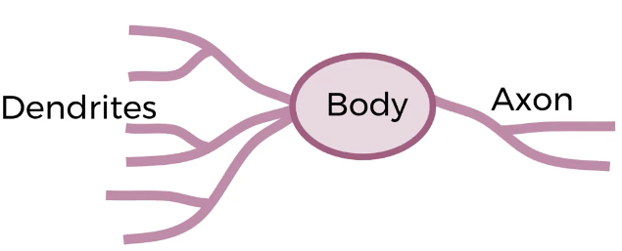
Biological Neuron

Slide 18
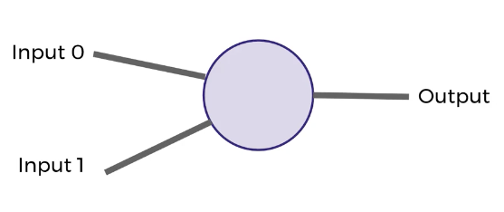
Conceptually

Slide 19
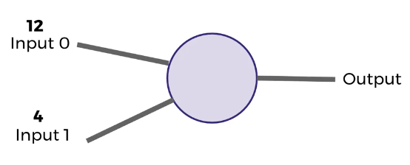
The dendrites receive an input

Slide 20
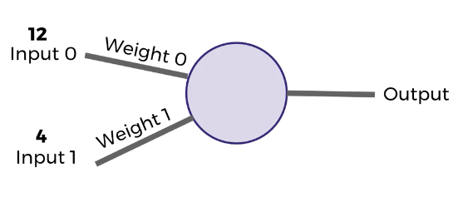
They inputs are subject to a weight

Slide 21
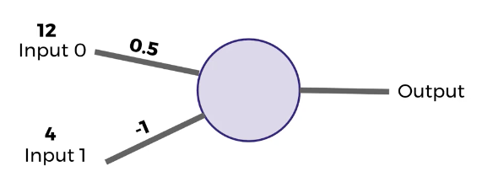
In the weights are initially give some value

Slide 22
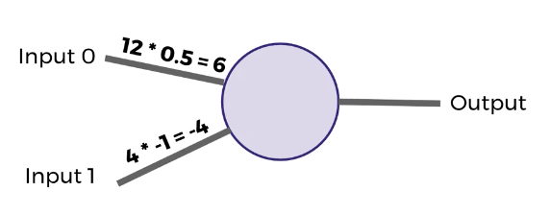
The inputs are multiplied by the weights

Slide 23
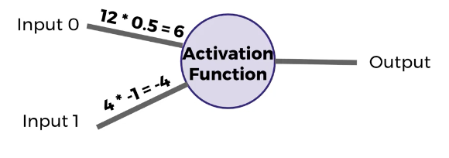
An Activation Function defines how to combine the inputs*weights and what will be passed on

Slide 24
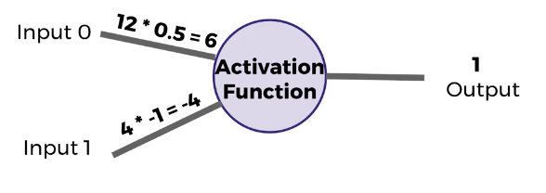
Simple AF: If positive, return 1, otherwise return 0

Slide 25
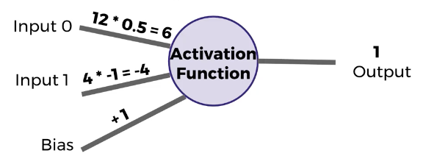
Add bias, so even if weights are both 0, we still can obtain a non-zero output

Slide 26
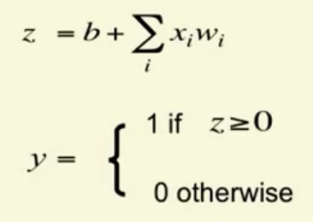
Simple Formulas, Sum of products and binary activation

Slide 27
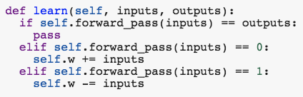
Perceptron Learning Algorithm
If the output is correct, leave weights alone
If the output unit incorrectly outputs a 0, add the input vector to the weight vector
If the output unit incorrectly outputs a 1, subtract the input vector from the weight vector

Slide 28
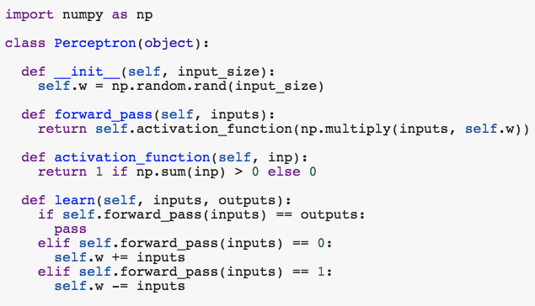
In code (link)

Slide 29
Neural Networks
Topology
Activation Functions
Loss
Optimizer
Back-propagation

Slide 30
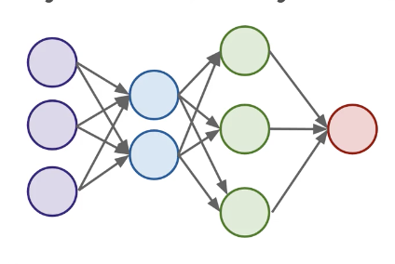
Input - Hidden Layers - Output

Slide 31
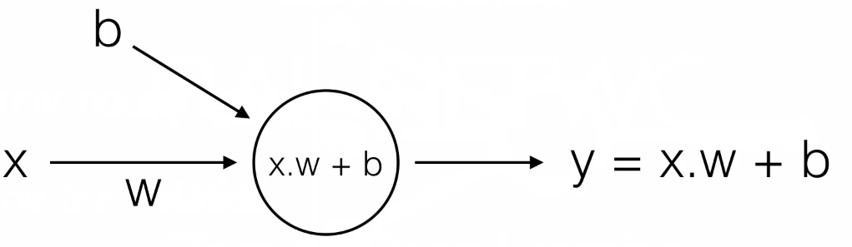
Neural Network with one layer and one unit (AKA linear regression)

Slide 32
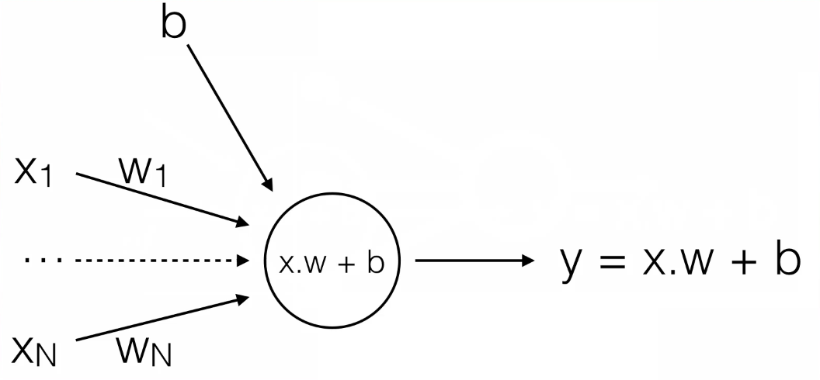
Multivariate Linear Regression
(Nothing New Here?)

Slide 33
What About Logistic Regression?

Slide 34
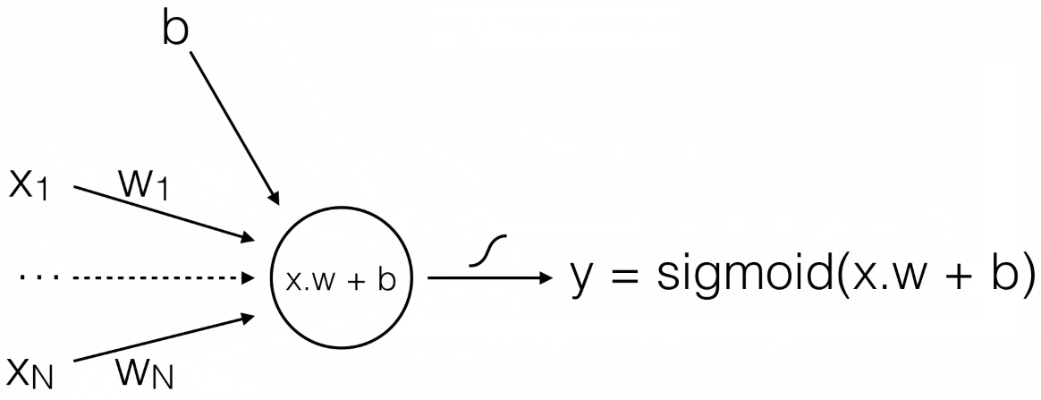
Just add a sigmoid and now we have Logistic Regression (binary output)

Slide 35
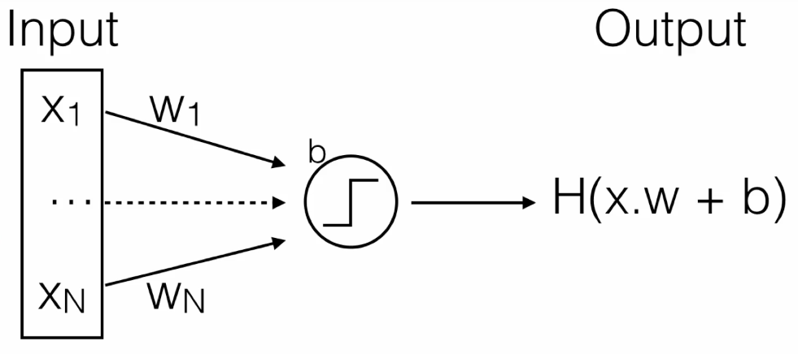
One Unit

Slide 36
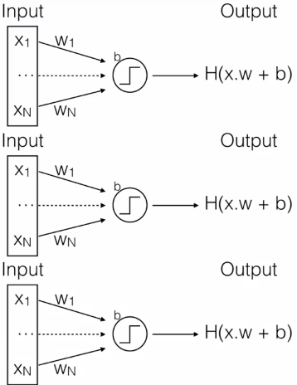
One Layer

Slide 37
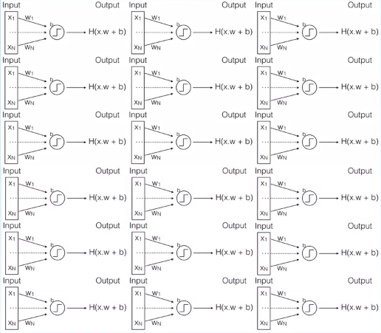
Multiple Layer

Slide 38
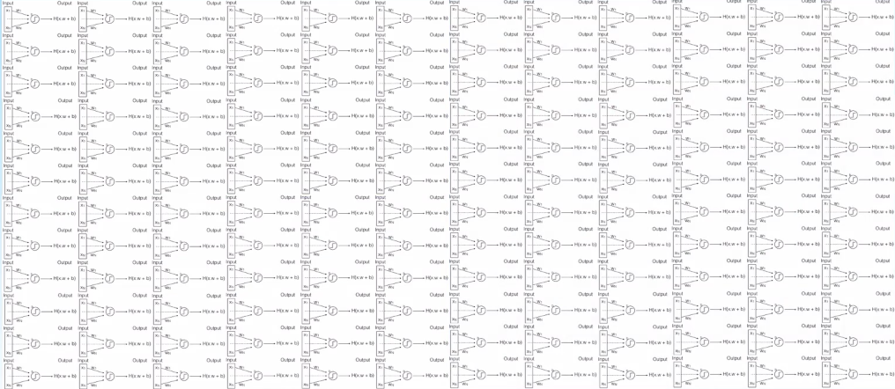
And so on...

Slide 39
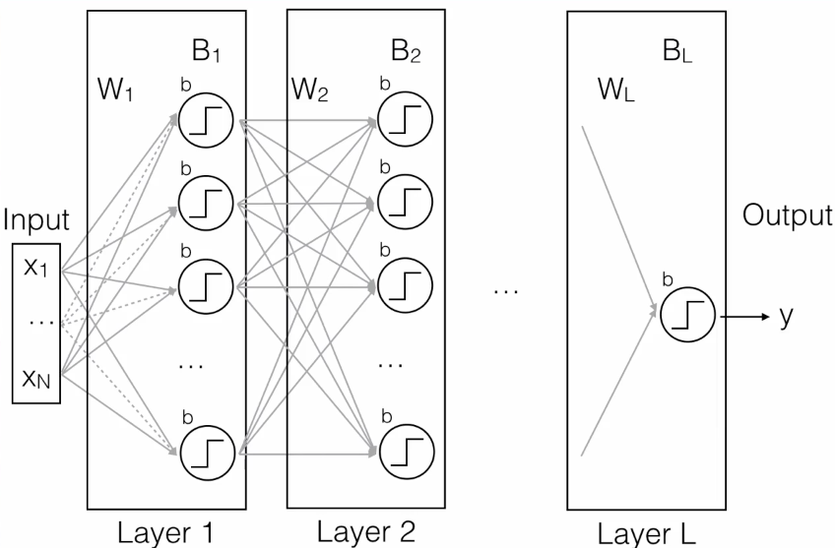
Each node in each layer is fully connected
Just one big f(x)=y
Takes inputs from a feature space and maps onto a target space. Same as all ML models
Multiply previous layer output by weights
Deform them with a nonlinearity
Pass transformed values along to next layer
And so on

Slide 40
Activation Functions
Defines the output of the node or neuron. This output is used as input for the next node
It maps the resulting values into the desired range using a simple function

Slide 41


Slide 42
Which one should we choose?
Most popular
Sigmoid or logistic
Tanh - hyperbolic tangent
ReLu - Rectified Linear Unit

Slide 43
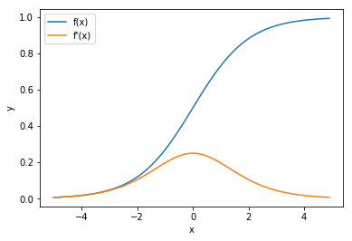
Sigmoid
It looks like the step function, but allows us to take into account small changes.
The original NN cost function
Vanishing Gradient, (degrading derivative) derivatives are too small
Requires initialization
Doesn’t work in large networks
Saturates and kills gradients
Slow convergence

Slide 44
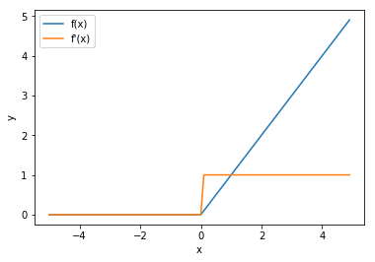
ReLu
Rectified Linear Unit
Max(0,x)
Most popular AF
Very simple and fast to calculate while staying non-linear
Derivative is fast to calculate and doesn’t degrade
Can sometimes “kill” neurons when always 0 derivatives

Slide 45
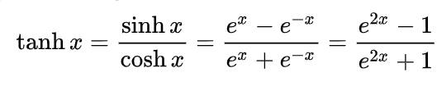
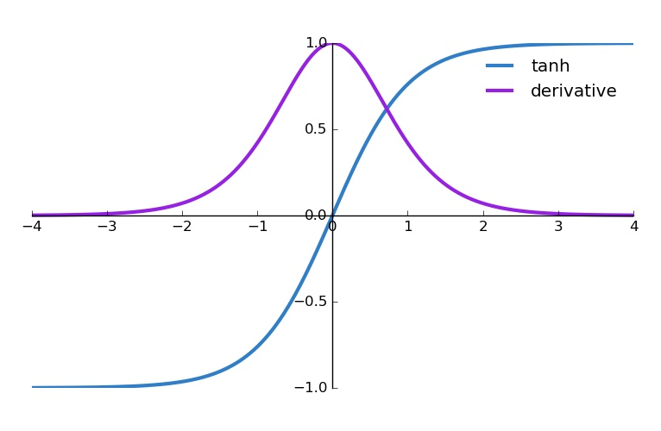
Tanh
Similar in most ways to the sigmoid
But is zero-centered, so easier to optimize
But still suffers from ...

Slide 46
Loss/Cost
How far off we are from the expected value, How wrong is my neural network (or my model in general)?
What are some examples of loss functions?

Slide 47
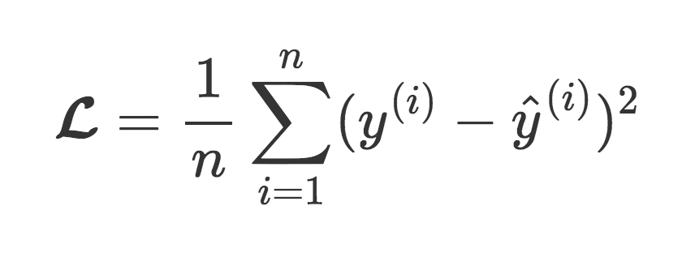
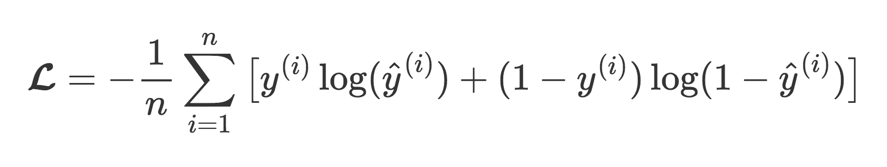
Types of Loss
Mean Square Error - Regression problems:
Categorical Cross Entropy - Classification problems:

Slide 48
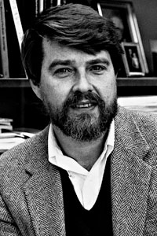
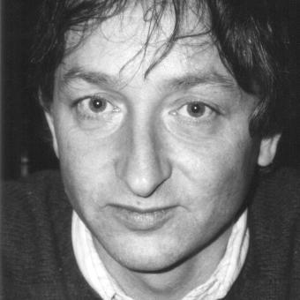
Optimizer - Backpropagation

Slide 49
Stochastic Gradient Descent
Stochastic gradient descent (often shortened to SGD), also known as incremental gradient descent, is an iterative method for optimizing a differentiable objective function, a stochastic approximation of gradient descent optimization

Slide 50
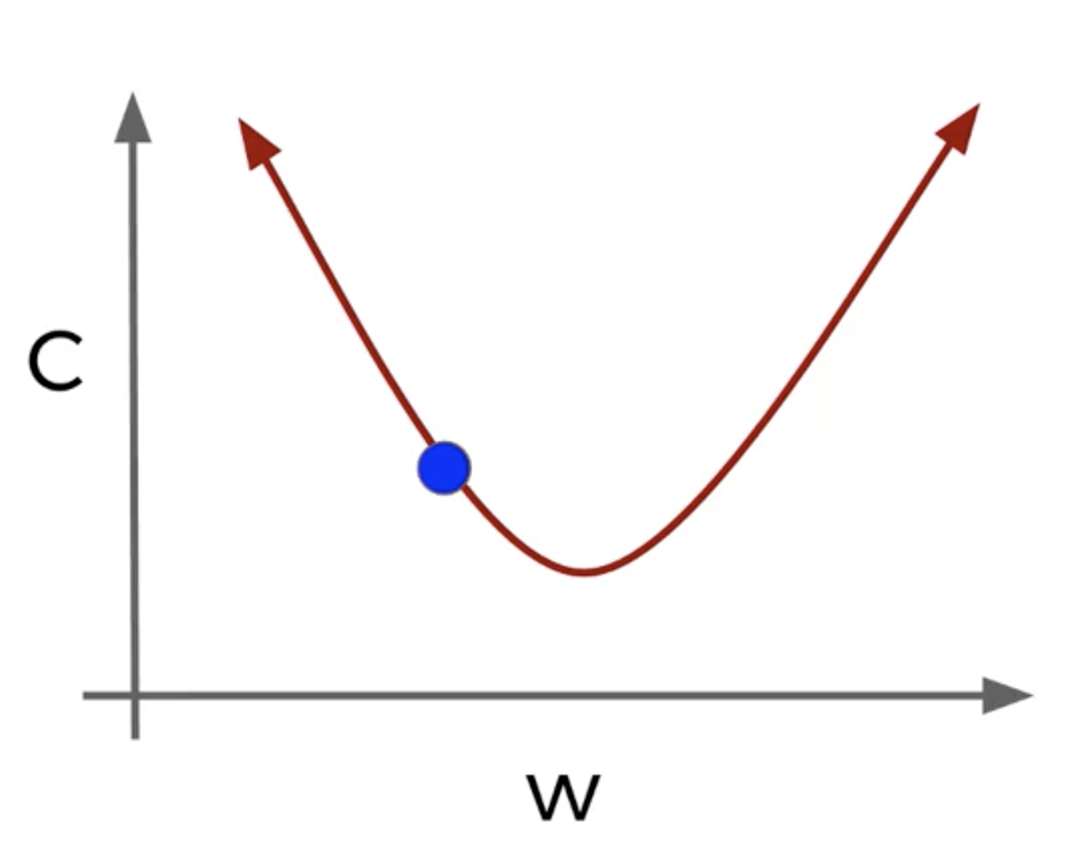
GD in 1 dimension

Slide 51
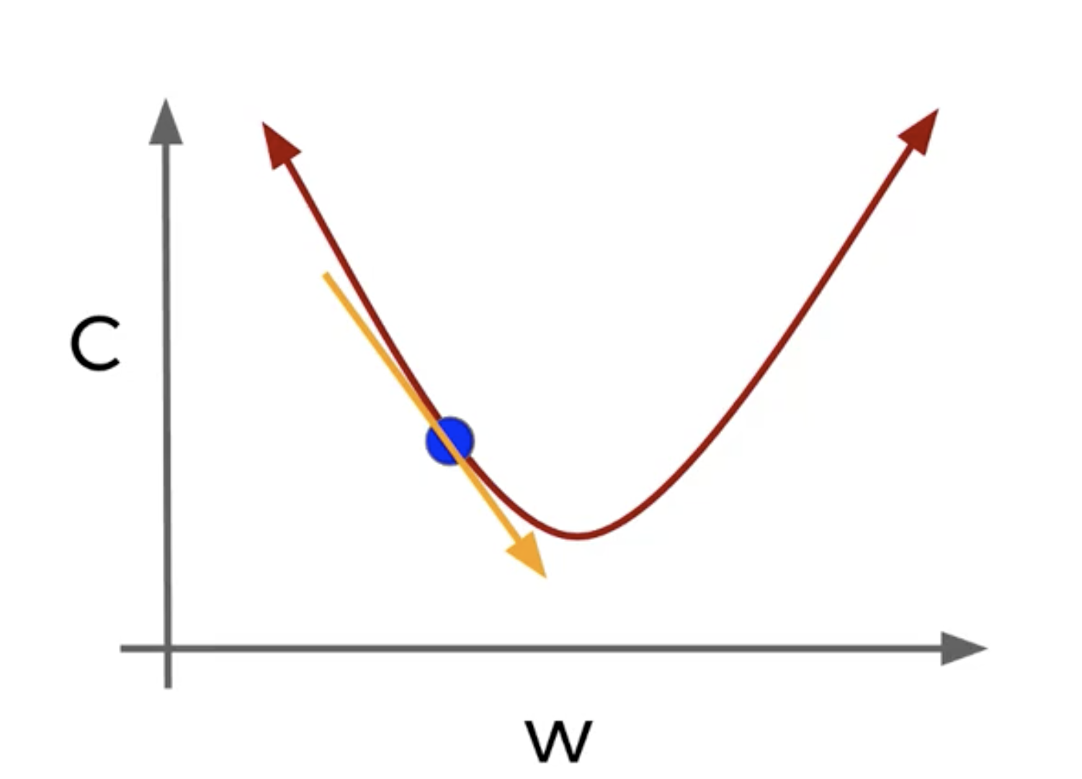
Slope of Tangent line and ‘descend’ along that line
New weight is equal to the old weight subtracted by the slope of the tangent line

Slide 52
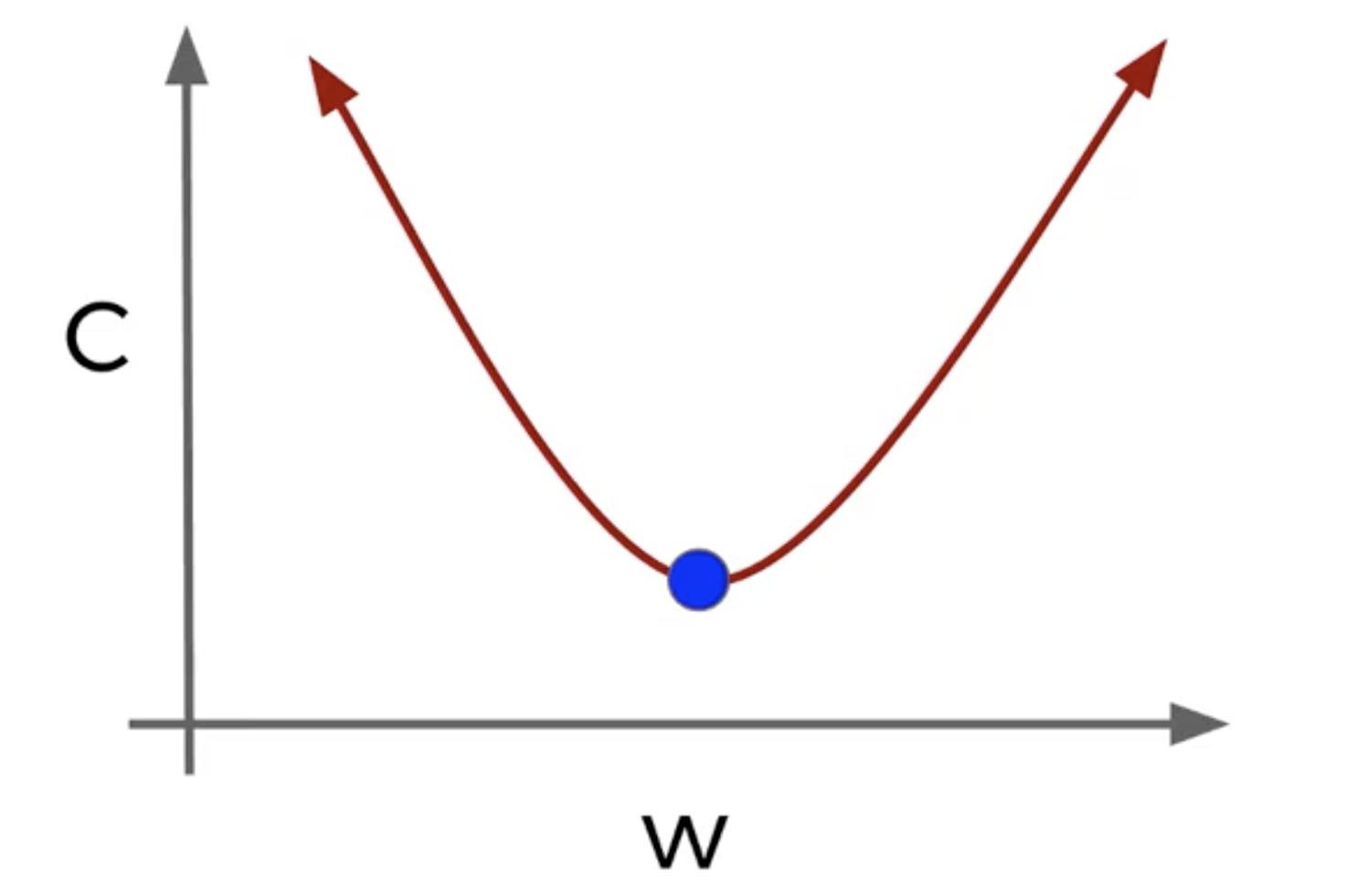
Until we can descent no longer

Slide 53
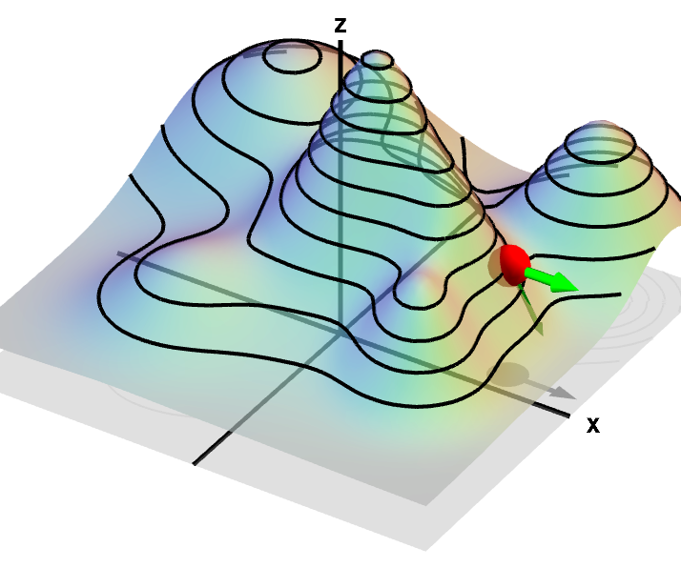
Partial Derivatives
*assume z is the error dimension
The shorted path down is not necessarily along the x or y dimensions, but rather a combination of both - partial derivative

Slide 54
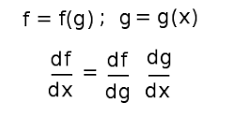
Chain Rule
The derivative of the entire neural network with respect to the input
Is equal to..
The derivative of the entire neural net wrt the previous node and the derivative of the previous node wrt the input
weight
weight
Input
bias
bias

Slide 55
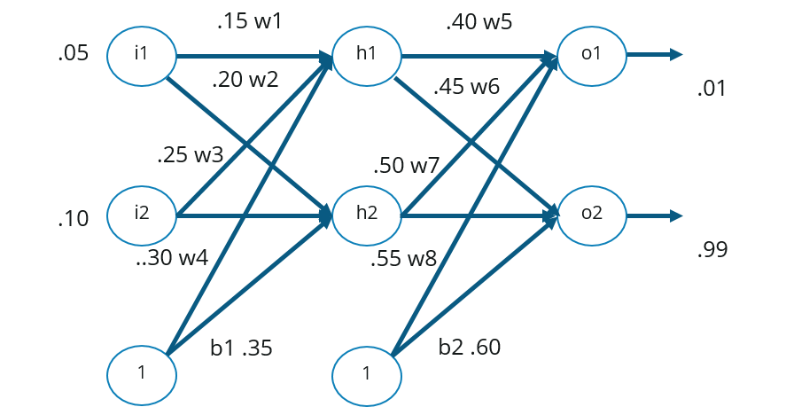
How it works

Slide 56

Different Flavors of SGD (link)

Slide 57
Tensorflow Playground
https://playground.tensorflow.org
Notes:
Simulation - TF written in javascript
Classify dots are blue or orange based on location
Shaded region is the predictions the model is making
Start with slow learning rate
See thickness of the lines, this means the weight it larger
The epoch is just the number of times we are feeding the data through each data point
Show test data checkbox and discretize output (no confidence)
More complicated example - circle pattern
Not making any progress
The shades become very light - the network is confused
Why? Because all we can do it exploit lines
Hover over hidden layers - each neuron has contributed a line
This is why we use deep neural nets - they can exploit more difficult patterns
How else we could have solved them?
What is the formula for circle x2 + y2 = something
Ahh here we get a perfect circle
We have done something called feature engineering - we have identified the right feature and fed it
We can throw all the features at it
We can mouse over the weights and see that the 3-4 features are better
The solutions converged more slowly, this is the penalty for not using the best features
Corner dots
What is the simplest way to solve the corner dots?
Easy!
Interlocking spirals
Throw all features at it!
There is just not enough parameters to play with - it will just never work
This is actually considered a hard problem - lots of problems have interlocking patterns. It's just that we can’t see them
How many parameters with 2 hidden layers? 8 - 5
Is this the best way to do this? No
But we didn’t use polar coordinates or fancy math, just this neural network does the work pretty good
This is actually quite magical, we just threw something at
So this is REALLY just trial and error guided by gradient descent

Slide 58
Simple Example of NN
http://bit.ly/2TAybmD

Slide 59
More Advanced Example
http://bit.ly/2XWKic1

